Slide 1

Computer Architecture

Slide 2
Revision
Buzz words:
Single Binary digit = bit
4 bits = nibble
8 bits = byte
16 bits = word
32 bits = longword
2 nibbles = byte
2 bytes = word

Slide 3



Revision
Logic Gates:
Logic gates are electronic circuits that operate on one or more input signals to produce an output signal.
The following represent the graphic symbols used to designate the three types of gates: AND, OR and NOT.
X
Y
Z = XY
X
Y
Z = X+Y
X
Z = X

Slide 4
Revision
Basic Identities of Boolean Algebra:
X + 0 = X
X.1 = X
X + 1 = 1
X.0 = 0
X + X = X
X.X = X
X + X = 1
X.X = 0
X = X

Slide 5
Revision
Commutative
X + Y = Y + X
XY = YX
Associative
X + (Y + Z) = (X + Y) + Z
X(YZ) = (XY)Z
Distributive
X(Y + Z) = XY + XZ
X + YZ = (X + Y)(X + Z)
DeMorgan’s
X + Y = X.Y
X.Y = X + Y

Slide 6
Revision
The following expression represents a digital circuit tested for mass
production. Can you make the same circuit for cheaper?
F = XYZ + XYZ +XZ
X
Y
z
F = XYZ + XYZ +XZ

Slide 7
Revision
Using Boolean algebra we can reduce the circuit as follows.
F = XYZ + XYZ +XZ
F = XY(Z + Z) +XZ identity 14
F = XY.1 +XZ identity 7
F = XY +XZ identity 2
X
Y
z
F = XY +XZ

Slide 8
Revision
So what does this really mean?
Well if all logic chips cost the same, for example one euro. Then the 100,000
circuits of the first design would cost in the region of 600,000 euro and the second
circuit would only cost 400,000 euro.
But how do we make sure that the logic circuits are the same? Meaning with the
same inputs they both yield the same outputs.

Slide 9
Revision
Using Truth tables we can verify logic design
F = XYZ + XYZ +XZ
X Y Z | XYZ | XYZ | XZ | F
T T T | F | F | T | T
T T F | F | F | F | F
T F T | F | F | T | T
T F F | F | F | F | F
F T T | T | F | F | T
F T F | F | T | F | T
F F T | F | F | F | F
F F F | F | F | F | F

Slide 10
Revision
Using Truth tables we can verify logic design
F2 = XY +XZ
X Y Z | XY | XZ | F2
T T T | F | T | T
T T F | F | F | F
T F T | F | T | T
T F F | F | F | F
F T T | T | F | T
F T F | T | F | T
F F T | F | F | F
F F F | F | F | F

Slide 11
Revision
Comparing the tables
F = XYZ + XYZ +XZ
F2 = XY +XZ
X Y Z | F | F2
T T T | T | T
T T F | F | F
T F T | T | T
T F F | F | F
F T T | T | T
F T F | T | T
F F T | F | F
F F F | F | F

Slide 12

Robotics

Slide 13
Today
Topics covered in this lecture
Formative Assessment Feedback
More logic design

Slide 14
Feedback
Formative Assessment Feedback

Slide 15
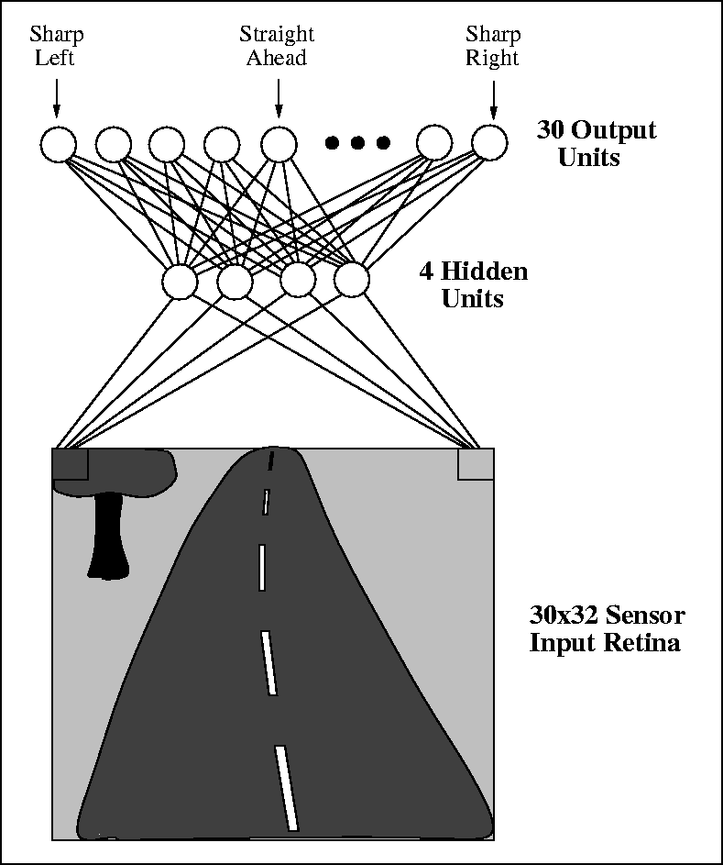
15 minute Break
Alvin

Slide 16
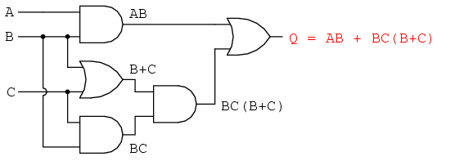
Using Boolean algebra to reduce design
Simplification of Circuits using Boolean Algebra
• Consider the following circuit:
We are using 5 gates to implement this circuit – can we do it better
than this?

Slide 17
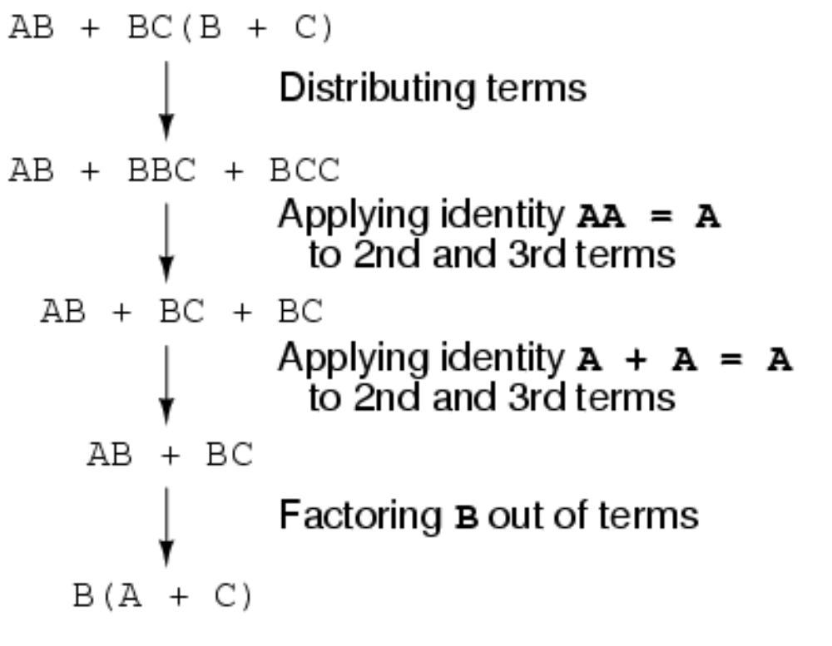
Using Boolean algebra to reduce design

Slide 18
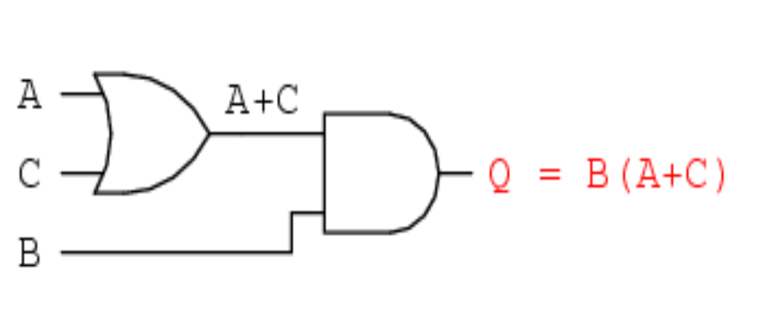
Using Boolean algebra to reduce design
This results in the following circuit.
Obviously, this circuit is much simpler than the original, having only two logic gates instead of five.
Such component reduction results in higher operating speed (less delay time from input signal transition to output signal transition), less power consumption, less cost, and greater reliability

Slide 19
Using Boolean algebra to reduce design
Consider:
(A.B(C + B.D) + A.B).C
(A.B.C + A.B.B.D +A.B).C {distribution}
A.B.C.C + A.B.B.C.D + A.B.C {distribution}
A.B.C + A.B.B.C.D + A.B.C {X.X = X}
A.B.C + A.0.C.D + ABC {X.X = 0}
A.B.C + A.B.C {0.X = 0}
A.B.C + (A +B)C {DeMorgans}

Slide 20
Using Boolean algebra to reduce design
A.B.C + (A +B)C {DeMorgans}
A.B.C + AC +BC {distributed}
BC( A +1) + AC {distributed}
BC( 1) + AC {X + 1 = 1}
BC + AC {X .1 = X}
C(B + A) {distributed}
CAB {DeMorgans}

Slide 21
Using Boolean algebra to reduce design
Questions:
Consider the following expressions, check if they are the most optimal setup. Using truth tables show that the two designs are equivalent.
F = AB(CD + AB + AD) + AD(C + D)
To Do

Slide 22
Today
Topics covered in this lecture
Formative Assessment Feedback
More logic design

Slide 23
Next Week
Next Week
Even More Logic Design!

Slide 24

Questions

